Slide 1
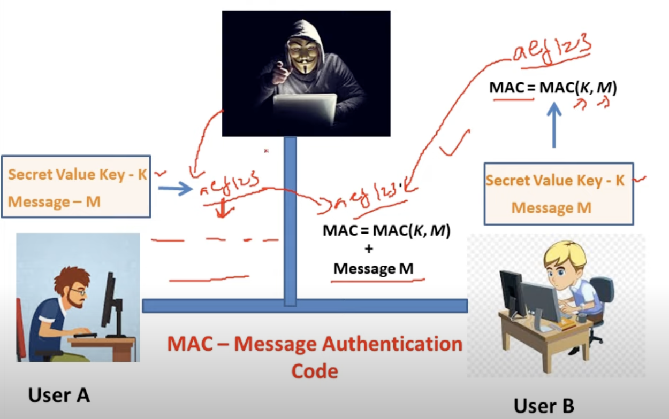
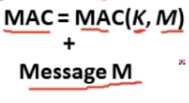

Slide 2
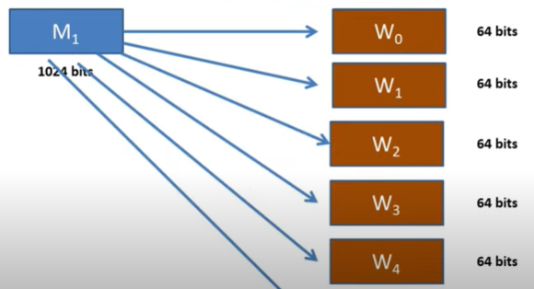
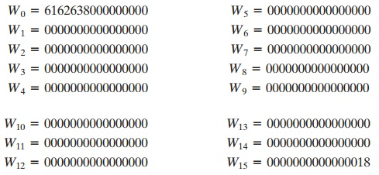
What is this module F?

Slide 3
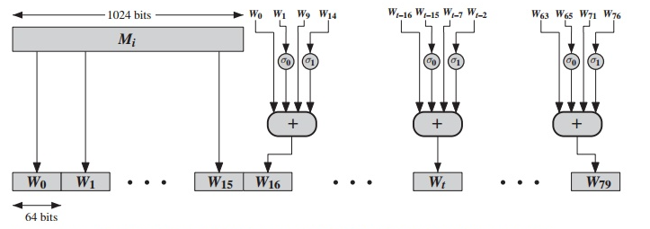
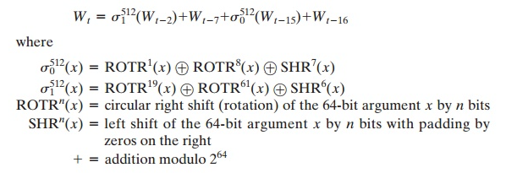
How to derive 80 words from 1024 bits

Slide 4
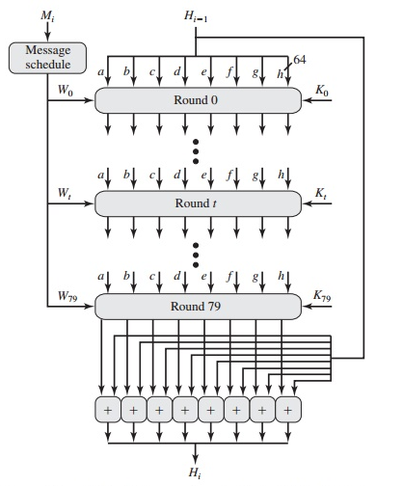

Slide 5
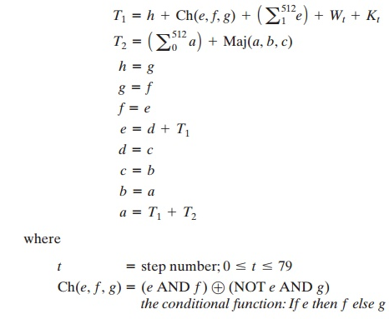
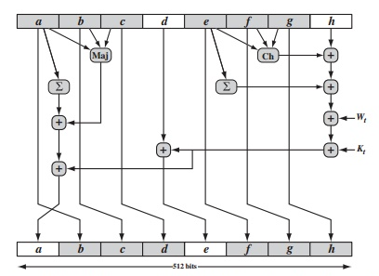
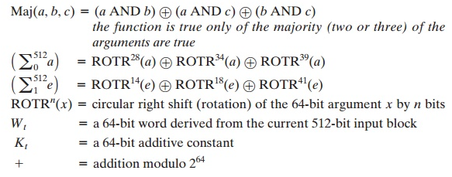

Slide 6
Message Authentication (MAC)

Slide 7
Message authentication code (MAC) is an authentic technique involves the use of a secret key to generate a small fixed size block of data.
MAC is not a digital signature.

Slide 8
Message Authentication
Message Encryption
Hash function
Message Authentication code (MAC)

Slide 9
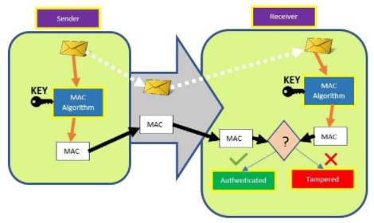
MAC

Slide 10
Hash based MAC (HMAC)
The idea of using a hash function to generate a MAC is relatively new.
HMAC or hash-based message authentication code was first defined and published in 1996 and is now used for IP security and SSL.
The advantage of using a hash-based MAC as opposed to a MAC based a block cipher is speed.
Hash functions like MD5 and SHA are generally faster in software than symmetric block ciphers like AES and DES.

Slide 11
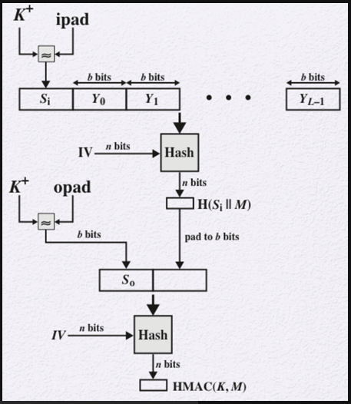
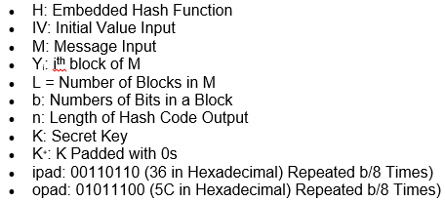

Slide 12
The HMAC structure follows these steps:
Append 0s to the left of K to create a b-bit string K⁺.
XOR K⁺ with ipad to produce the b-bit block S_{i}.
Append M to S_{i}.
Apply H to the stream generated in the previous step.
XOR K⁺ with opad to produce the b-bit block S₀.
Append the hash result from step 4 to S₀.
Apply H to the stream generated in step 6 and output the result

